Slide 1
Structured Topic Modelling
A Presentation of the work done by Anna-Grace Linton during her PhD internship with NHSX.
https://github.com/nhsx/stm-survey-text
Paul Carroll
Senior Data Scientist
Digital Analytics and Research Team (DART)
Paul.carroll9@nhs.net
November 2022

Slide 2
What Is Structured Topic Modelling?
“Structured Topic Modelling (STM)
is a form of topic modelling
specifically designed with social science research in mind.” (Lebryk)
STM allows us to incorporate metadata into our model
and uncover how different documents
might talk about the same underlying topic
using different word choices.

Slide 3
What makes STM different and why use it?
STM allows us to incorporate metadata into our model and uncover how different documents might talk about the same underlying topic using different word choices.
STM is an unsupervised Text Classification technique incorporating metadata covariates.
“Currently the majority of survey analyses are closed-ended questions” Structural Topic Models for Open-Ended Survey Responses – Roberts et Al – 2014
Metadata important, time, location, date occur alongside topic prevalence. Estimate topic relationship alongside metadata, for example, “feedback during winter may include details about longer wait times and demand on services.
In LDA, topic prevalence comes from Dirichlet distributions with hyperparameters set in advance, with STM topic prevalence and content come from document metadata.
UK Government examples of use: ‘Public opinion about the UK Government during Covid 19 and implications for public health’, Wright et al, March 2021.

Slide 4
The Project Scope
Request came from the CTAS (Contract Tracing Advisory Service) team to extract value from their open-ended survey data. IG problem with data. Metadata included time, date and location. Intuitively this adds tremendous to the quality of the model output.
Substituted Nottinghamshire Healthcare NHS Foundation Friends and Family Feedback survey, 10,344 patient feedback responses with metadata.
Metadata contained within included, criticality (-4 : 4), organization, and question. Label, code, and subcategory(Staff, general, provision of services) were not used as metadata in the experiments.

Slide 5
STM – The Approach (1)
- STM package in R.
Open-source libraries for NLP used alongside STM were tidytext, LDAvis.
Preprocessing could be amended to include medical libraries, added to stopwords.
- N-gram analysis, Sentiment Analysis (Vader) for additional insight.
- Semantic Coherence & Exclusivity score for each topic within a model.
STM ran on K=5->65 topics using searchK.
Semantic Coherence, exclusivity score, heldout log-likelihood and lower bound used to determine number of topics for the model. Smaller number then re-run, K=(20,25,30)
- Models evaluated by FREX score. FREX score is the frequency of a word in a topic, and its exclusivity to a topic.

Slide 6
STM – The Approach (2)
- STM Insights package
Thinking of the user, for example, an analyst in a NHS trust, how can we add additional utility to this project.
- Text Search via pop-up box. Runs on already processed topics.
This was done using Wordnet library in R, for single or multi-word phrases.
This enables the user to specify a first word in the topics, e.g. Staff, and then search for topics that also contains a second word or set of words; Doctor, Nurse.

Slide 7
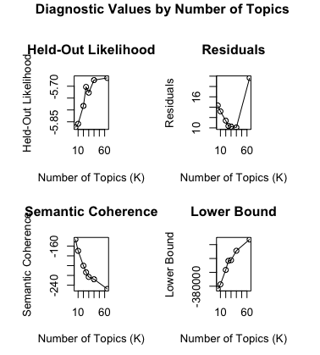
Results
STM enables higher quality models, and provides insights into the corpus such as how metadata affects the words a document uses within a topic.

Slide 8
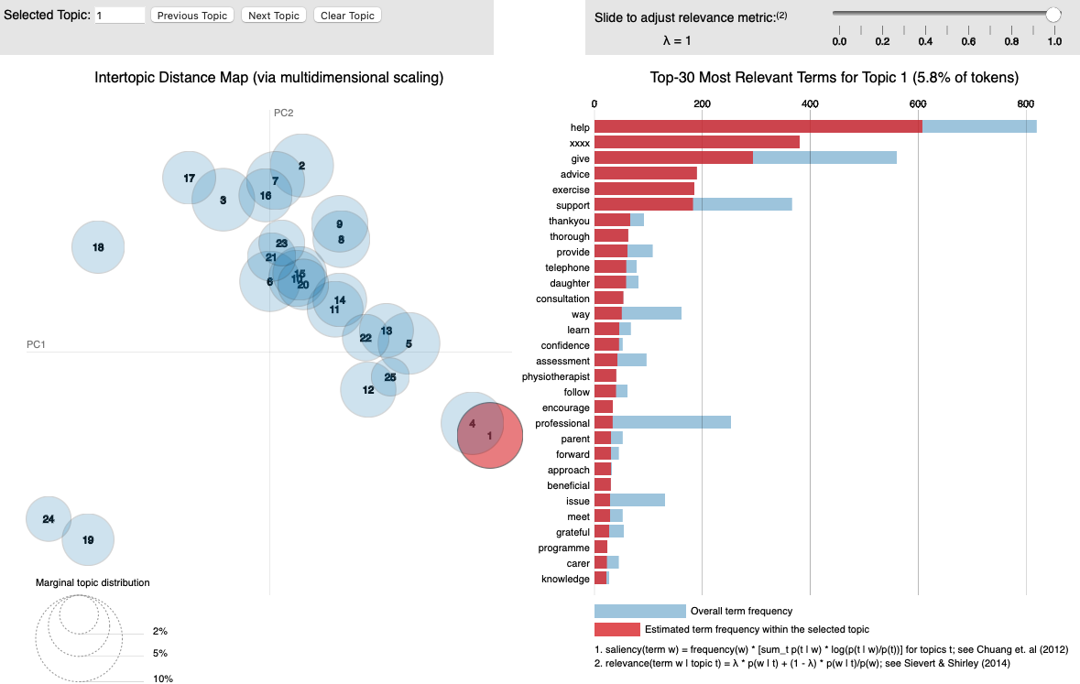
Visualisations – LDAVis

Slide 9
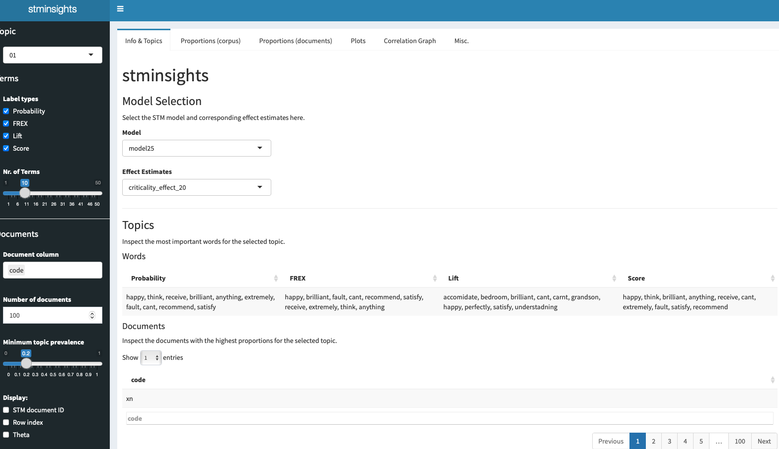
Visualisations – stmInsights (1)

Slide 10
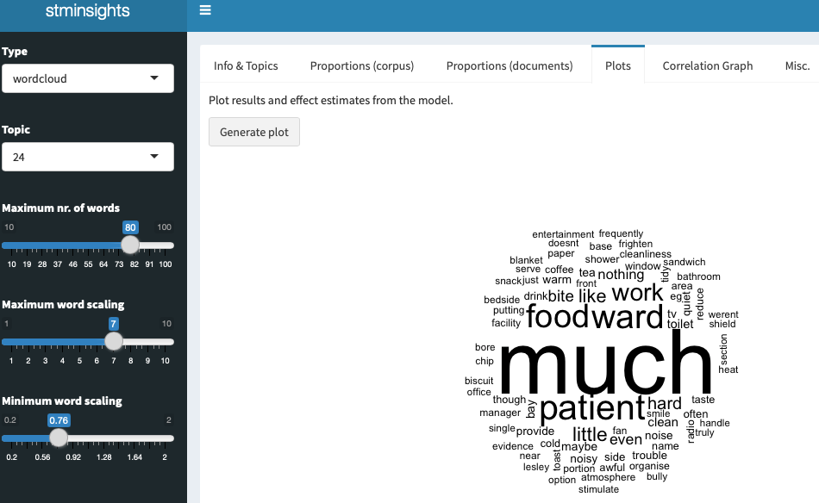
Visualisations – stmInsights (2)

Slide 11
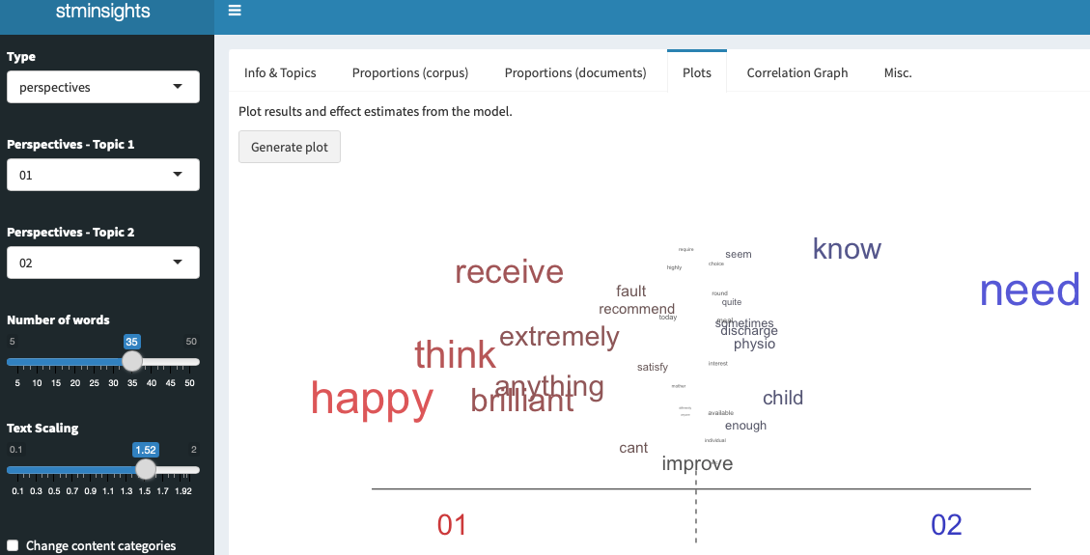
Visualisations – stmInsights (3)

Slide 12
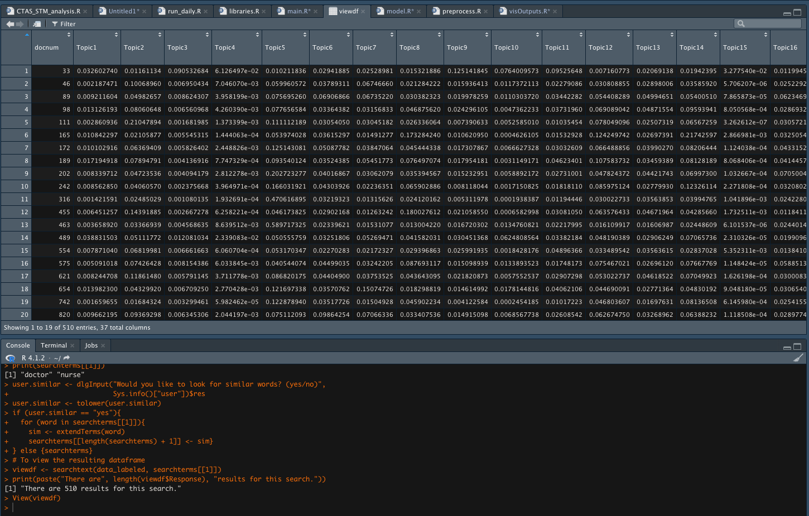
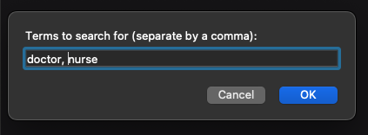
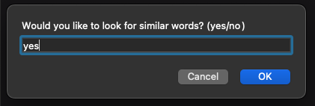
Text Search

Slide 13


Visualisations – sageLabels & findThoughts

